Slide 1
Defining Success with ML Systems
Geoff Hutlen

Slide 2
Goal for SMS spam
Train a model like this and you’ve got victory!
Operating Point: 1% FPR
Block > 95% of the spam
Wrong operating points?
- 0.5% FPR better?
- 1.0% FNR better?
What Could Go Wrong?
Maybe these aren’t the right targets
  Users hate it
  Spammers ignore it
Maybe the problem changes
  Spammers send 20x more spam…
  Spammers send 20x less spam…
Maybe the FPs are distributed poorly…
  Totally shut down all bank statements
  Totally shut down all small senders
Maybe no one knows what you're talking about…
  Management has no idea what a FN is
  Move FN metric, but don’t move business metric
Wrong metrics?
- Same FNR, more spam
- Same FPR, less value
- PR better?
Delta:
Wrong test data?
- Missing critical sub-populations?
- Some errors more costly than others?
Wrong vocabulary / concepts?
- Technical terms don’t map across participants
- ML goals not tied to actual goals

Slide 3
Properties of a Good Goal
Communicate desired outcome
  What is success and why is it important
  In the language of all participants
Achievable
  Participants can see a path toward success
  Even if it’s difficult…
Measurable
  Quantify benefit of progress and cost of failure
  Evaluation is creation
New “mysterious” ML vocabulary added to discussions
ML requires new intuitions about what is easy and what is hard
ML just another tool, not a magic problem solving box
Setting the right goals for ML is just about the hardest, most frustrating and most important part of using ML in practice

Slide 4

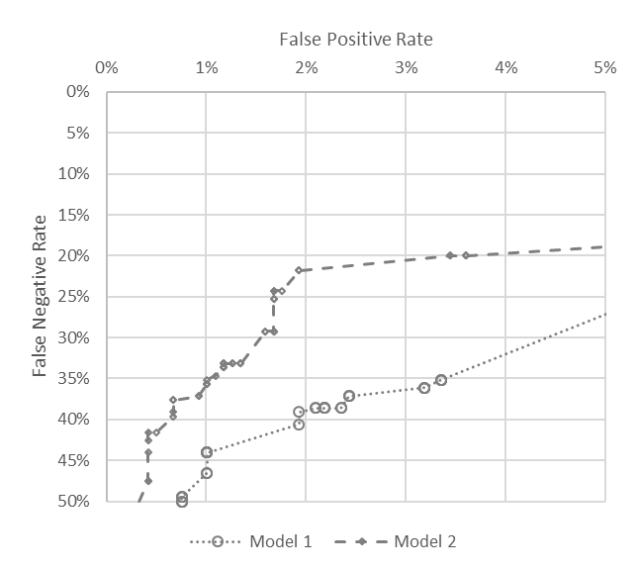
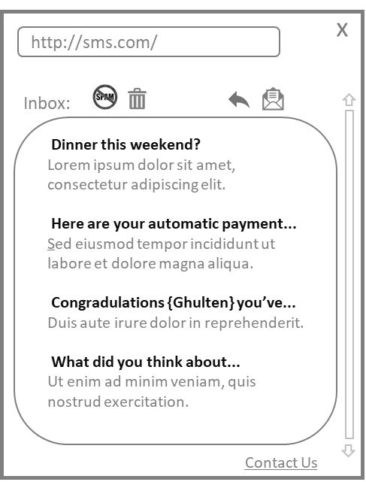
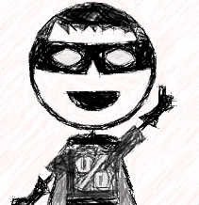

More Detail on SMS Spam
100 Non-Spam Per Week
1000 Spam Per Week
1% FPR
5% FNR
1 FP per week
50 inbox spam per week
Friends who message you
Spammers who know about you
What the World Does
What the Model Does
What the User Sees
Inbox ~33% Spam

Slide 5
Types of goals
Model Properties
User Outcomes
User Churn
User studies show 80% think we’re good at spam
Profit
Models + UX Create
Monthly Active Users
Subscription Revenue Growth
‘bad’ FPR < 0.1%
New spam attack stopped in < 1 hour
Users spend less of 2% of time in app on spam
Good Outcomes Improve
FNR < 5% & 1% FPR
User sees less spam than on competitor
Leading Indicators
Organizational Objectives
Precision = 99%
Avg User reports < 1 spam a month
Cost of managing spam < 1% of service cost
Happy, Engaged Users Lead to
Monthly Sent per User
Total cost (FP 10; FN 1)
Users recommend the service to their friends
User sees fewer than 5 spam a week
Avg User Inbox < 5% spam

Slide 6
Connecting Model Properties to User Outcomes
Will change over time
Current FN Rate
~4-5 points of ‘% Inbox is Spam’ per point of FNR
User Outcomes
Complex Relationship over Time
Short Term Gradient
Model Properties

Slide 7
Connecting Outcomes to Leading Indicators
Diminishing Effect of Bad User Outcomes on sentiment
Bad User Outcomes with large effect on sentiment
Leading Indicators
User Outcomes
Model Properties
Affected by many things and changes slowly
Don’t expect model launch to change it overnight

Slide 8
Connecting Outcomes to Leading Indicators
Bad User Outcomes with large effect on sentiment
Leading Indicators
User Outcomes
Model Properties
Diminishing Effect of Bad User Outcomes on sentiment
Work on other problems:
- FPR
- Latency
- Cost to run

Slide 9
Putting it Together
Setting a goal for your ML
Organizational Objectives
2% of User Churn
10k Monthly Saving
Leading Indicators
.5 of a star rating
User Outcomes
4-5 points of ‘% of Inbox is Spam’
Model Properties
1% of FNR

Slide 10
Why not Optimize Actual Goal Directly?
Indirect Relationship
  Effect of single actions small
  Long delay for feedback
  Affected by many things
    User Experience
    Competitors
    Marketing
    Interactions with other parts of the system
    Changing concepts
  Relatively few observations
ML on Concrete Sub-problem
  Large (local) effect of actions
  Quick feedback
  Context contains most of the relevant info
    Can get quick implicit feedback
    Can inspect context and hand-label
  Many, many observations

Slide 11
Summary
Setting goals for ML systems is frustrating, difficult, and critical
Good goals:
  Communicate success
  Inspire participants
  Are Measurable
Hierarchy of Goals
  Model properties → user outcomes → leading indicators → organizational success
Global relationships complex, local approximations help
Need to invest to keep goals healthy over time

